Slide 1
Overview – The Social Science Perspective on Networks and Norms
Julian Kohne

Slide 2
Psychology of Groups
Notes:
Two aspects of belongingness: frequent interactins with the same people + stable and enduring context of concern and caring
People differ in their extent of need to belong, however, it is a culture-independent strong fundamental need:
Evolutionary perspective: Forming a group has costs and benefits depending on the species and their environment (e.g. bears would kill any eco system if they formed groups and die out). For primates, small, tightly knit groups seem to be the evolutionary niche -> Enough food, coordinated hunting, mating, protection -> The strong desire to be part of a group seems to be a biological predisposition created through natural selection. - groups form in all cultures, societies and cirumstances
Groups form easily, even under bad or extreme conditions (e.g. war)
People are generally reluctant to break social bonds
Being excluded or ostracized hurts (ignarance is not as bad as active exclusion)
Happiness is strongly correlated with close personal relationships
Social isolation is related to feelings of anxiety and depression
Just imagining social exclusion leads to physical arousal

Slide 3
Psychology of Groups
What is a group?
„a collection of individuals who have relationships to one another“ (Cartwright & Zander, 1968)
„a social unit which consists of a number of individuals who stand in definite status and role relationships to one another“ (Sherif & Sherif, 1956)
„a bounded set of patterned relations among members“ (Arrow, McGrath & Berdahl, 2000)
„A group is a collection of two or more individuals who are connected by and within social relationships“ (Forsyth, 2010)

Slide 4

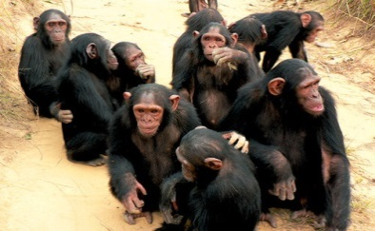
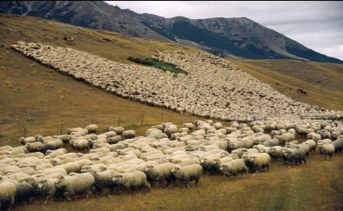
Psychology of Groups
Humans are fundamentally „social animals“ (Aristotle)
Need to Belong
„pervasive drive to form and maintain at least a minimum quantity of lasting, positive, and impactful interpersonal relationships“ (Baumeister & Leary, 1995)
Biologically, there seems to be a continuum with intra- and interspecies differences.
Solitary
Herd
Notes:
Two aspects of belongingness: frequent interactins with the same people + stable and enduring context of concern and caring
People differ in their extent of need to belong, however, it is a culture-independent strong fundamental need:
Evolutionary perspective: Forming a group has costs and benefits depending on the species and their environment (e.g. bears would kill any eco system if they formed groups and die out). For primates, small, tightly knit groups seem to be the evolutionary niche -> Enough food, coordinated hunting, mating, protection -> The strong desire to be part of a group seems to be a biological predisposition created through natural selection. - groups form in all cultures, societies and cirumstances
Groups form easily, even under bad or extreme conditions (e.g. war)
People are generally reluctant to break social bonds
Being excluded or ostracized hurts (ignarance is not as bad as active exclusion)
Happiness is strongly correlated with close personal relationships
Social isolation is related to feelings of anxiety and depression
Just imagining social exclusion leads to physical arousal

Slide 5
Psychology of Groups
Features of Groups (Forsyth, 2010)
Interaction
Members of groups are connected through some form of interaction
Interdependence
Experiences, actions, thoughts and feelings for group members are not independent from each other
Goals
group members share the same goals
Structure
There exists an underlying pattern of norms, rules and relations that guides conduct
Unity
The group is more than the sum of its parts. It becomes a social unit on ist own.
Identification
Members identify themselves as part of the group
Entitativity
Others perceive the group as a social unit

Slide 6
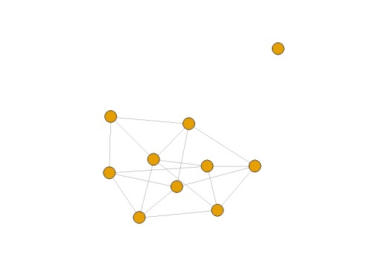
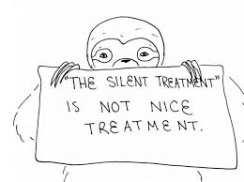
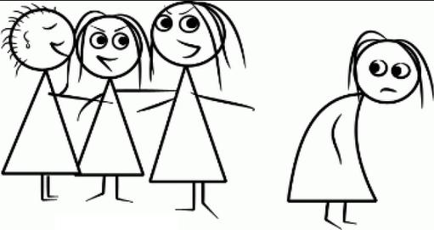
Psychology of Groups
Being socially isolated „hurts“
Ostracism: „any act or acts of ignoring and excluding of an individual or groups by an individual or a group “ (Williams, 2001)
Feeling ostracized “and physical pain share common physiological mechanisms” (MacDonald & Leary, 2005)
Active Inclusion
Passive Inclusion
Ambivalence
Passive Exclusion
Active Exclusion
Maximum Exclusion
Maximum inclusion
Notes:
Spectrum of exclusion rather than binary process (More inclusion fulfills the need to belong better)
Ostracism:
- elevated blood pressure & cortisol levels
- active dorsal enterior cingulate cortex (otherwise active in the processing of physical pain)
- lower T-cell count and immune system activity among lonely individuals
- close personal relationship act as a buffer against stress
Measurable Consequences:
Mortality rates in the US are consistently higher for single, widowed and divorced people than
for people in relationships across all causes of death
Admissions to mental hospitals are at least 3x more likelyfor divorced and single than for people in a relationship
PTSD is much more common among soldiers who report that they feel lonely

Slide 7
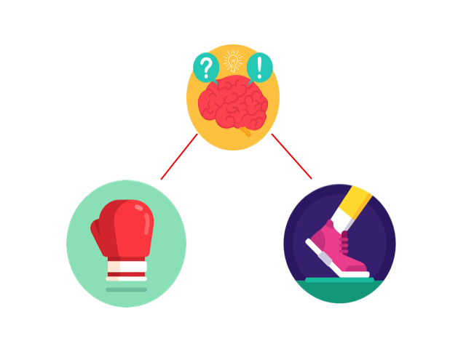

Psychology of Groups
Different kinds of reactive schemata in response to social exclusion from a group
Notes:
Different reactions towards social exclusion from a group: 1) Fight or flight: fighting back against the exclusion or escaping the situation (confront group members directly, refuse to leave, derogate the group / accept rejection and leave) 2) Tend and befriend: Nurture, protect and support others or strengthening individual relationships with specifc group members, become more cooperative, evaluate new acquaintances more positively Men are more likely to respond according to the first schema, women are more likely to respond according to the second schema -> Women are more likely than men to blame themselves for being ostracized.

Slide 8
Psychology of Groups

Slide 9
Psychology of Groups
Types of Groups (Forsyth, 2010)
Primary Groups
Small, long-term groups characterized by ftf interaction, solidarity and high levels of interdependence and identification (e.g. families, close friendships, romantic partners)
Social Groups
Relatively small number of people who interact with each other over an extended period of time. More formally organized and less emotionally involving than primary groups (e.g. work groups, clubs, teams)
Collectives
A relatively large aggregation who display similarities in actions and/or outlook. Larger, more spontaneously formed and less temporally stable than social groups. (e.g. street crowd, audience in the cinema, mass movements)
Social Categories
An aggregation of people that share some common attribute or are related in some way

Slide 10






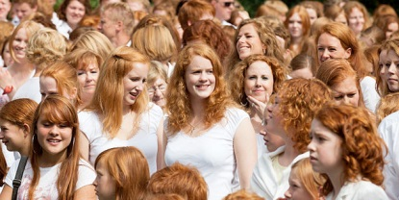


Psychology of Groups
Examples of Groups:
Primary Groups
Social Groups
Categories

Slide 11
Psychology of Groups
Social Brain Hypothesis (Dunbar, 1992)
The capacity to form and maintain social relationships is related to the cognitive capacity of our brains.
Capacity for social relationships as finite resource
Maintaining close social relationships is cognitively more expensive than maintaining loose ones.
Dunbars number: The number of meaningfull social ties that humans can successfully maintain is roughly limited to 150.
Not all relationships have equal weight and there is some evidence for different layers of relationships with decreasing emotional closeness.

Slide 12
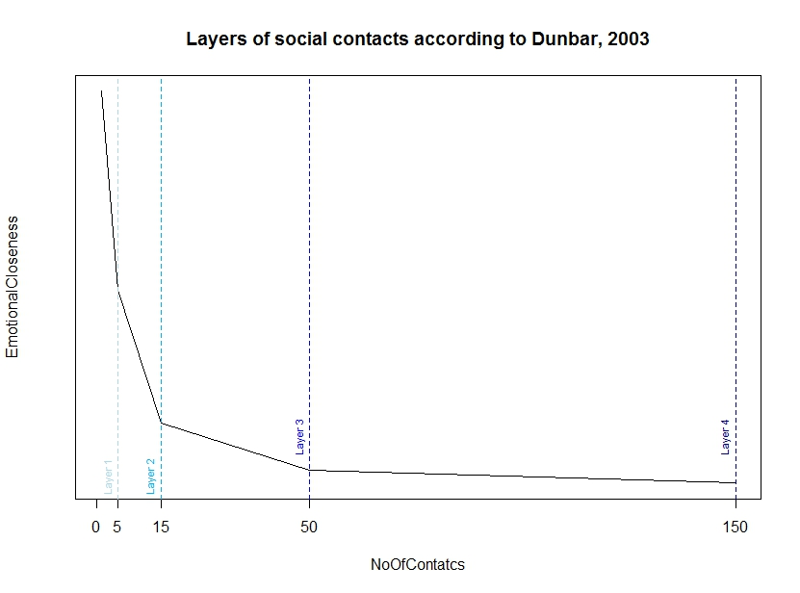
Psychology of Groups
Social Brain Hypothesis (Dunbar, 1998; Dunbar & Hill, 2003)
Similar dynamics have been observed in:
Facebook & Twitter (Dunbar et al, 2015)
Online Games (Fuchs et al, 2014)
Phone Calls (Carron, Kaski & Dunbar, 2016)
Notes:
As a new intimate relationship develops, people tend to reduce their time spent with other social contacts, including

Slide 13
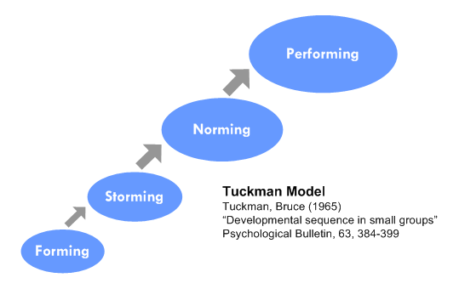
Psychology of Groups
Developmental Sequence in Small Groups (Tuckman, 1965)
Forming: Group members orient themselves towards each other.
Storming: Establishing roles and hierarchy, coined by uncertainty and conflict
Norming: Group becomes more structured. Norms and standards for conduct emerge
Performing: Group cooperates to achieve common goal.
Adjourning: Group disbands
Example: Group Projects in University
Notes:
Maybe we will recognize some of these stages in our group aswell?

Slide 14
Psychology of Groups
How do individuals relate to groups?
Social Identity Theory (Turner & Tajfel, 1986)
Individuals strive for a positive social identity
Part of this identity is the membership in different groups and the evaluation of these groups.
Positive social identity is constructed by comparison with outgroups
Should the comparison result in a negative evaluation, people are motivated to leave the group or to (unconsciously) enhance the perception of their ingroup
Notes:
Minimal group paradigm <-> Minimal intergroup situation

Slide 15
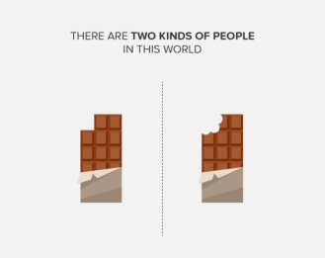

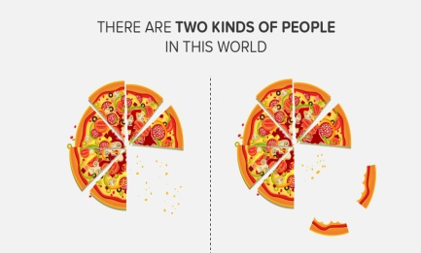
Psychology of Groups
Social Identity Theory (Turner & Tajfel, 1986)
People belong to a variety of different groups that make up their identity:
Age, Gender, Nationality, Sexual Orientation
Political Parties, Sports Teams, Music Genres
Basically any trivial distinction between people can seperate them into groups
The process by which people put themselves into these cateories is called social categorization
Notes:
Minimal group paradigm <-> Minimal intergroup situation

Slide 16
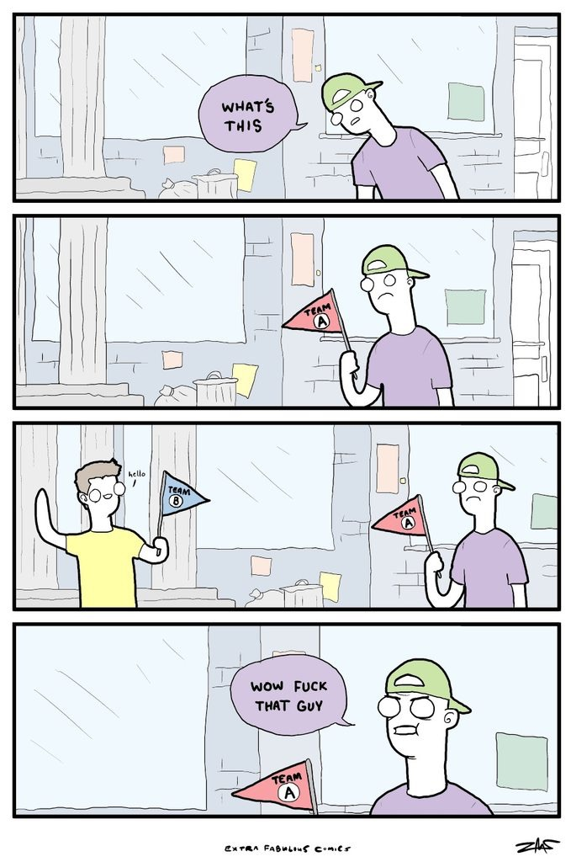
Psychology of Groups
Social Categorization
Minimal Group Paradigm: Any perceivable
differentiation between two types of people is
sufficient to elicit categorization into „us“ and
„them“.
Nationality
Age
Gender
Music Taste
I
Notes:
Minimal group paradigm <-> Minimal intergroup situation

Slide 17
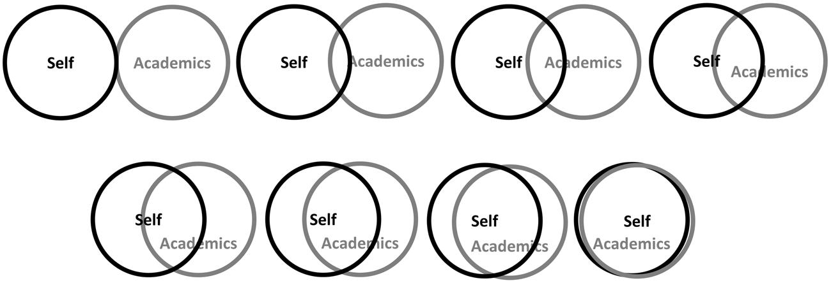
Psychology of Groups
Social Identification
People identify to different degrees with different aspects of their social identities
Notes:
Minimal group paradigm <-> Minimal intergroup situation

Slide 18
Psychology of Groups
Social Identification
People identify to different degrees with different aspects of their social identities
Notes:
Minimal group paradigm <-> Minimal intergroup situation

Slide 19

Psychology of Groups
Social Identification
People identify to different degrees with different aspects of their social identities
Notes:
Minimal group paradigm <-> Minimal intergroup situation

Slide 20

Psychology of Groups
Social Identification
People identify to different degrees with different aspects of their social identities
Notes:
Minimal group paradigm <-> Minimal intergroup situation

Slide 21


Psychology of Groups
Identity Salience
People identify to different degrees with different aspects of their social identities
However, social identification is not a static property but can change in response to cues from the social environment.
Notes:
Minimal group paradigm <-> Minimal intergroup situation

Slide 22
Psychology of Groups
Meta-Contrast Principle
People will form groups along the lines of the the most salient identity dimensions depending on social context.
Music Festival -> Music Taste
Football game -> Teams
Vacation Resort -> Nationality
Groups will form by maximizing the similarity between group members and minimizing the similarity to outgroup members
Ingroup : Similarities are maximized
Outgroup: Differences are maximized
Notes:
Minimal group paradigm <-> Minimal intergroup situation

Slide 23
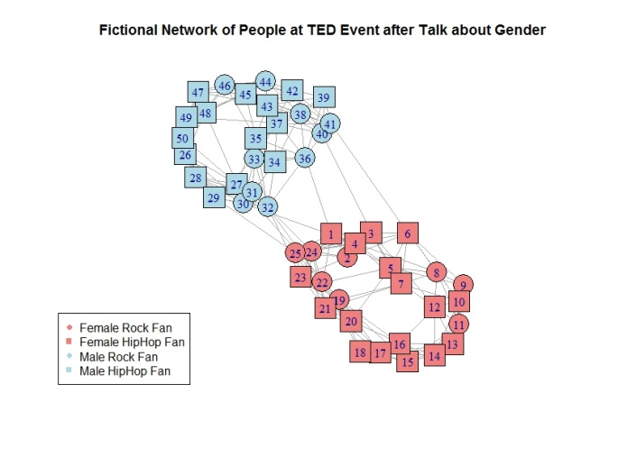
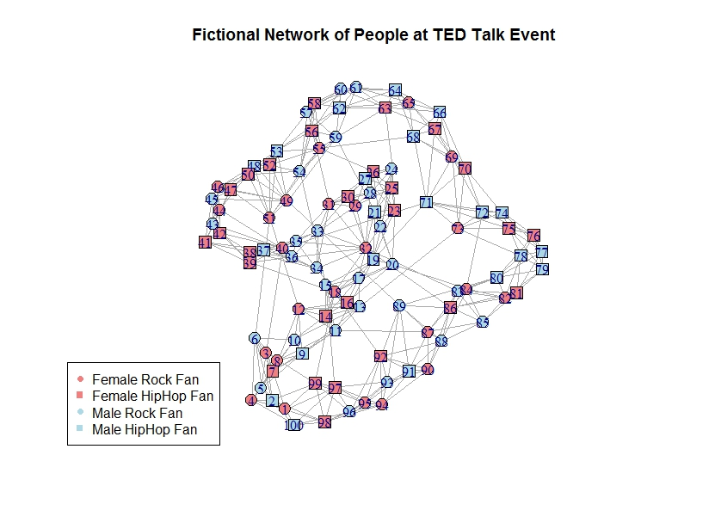
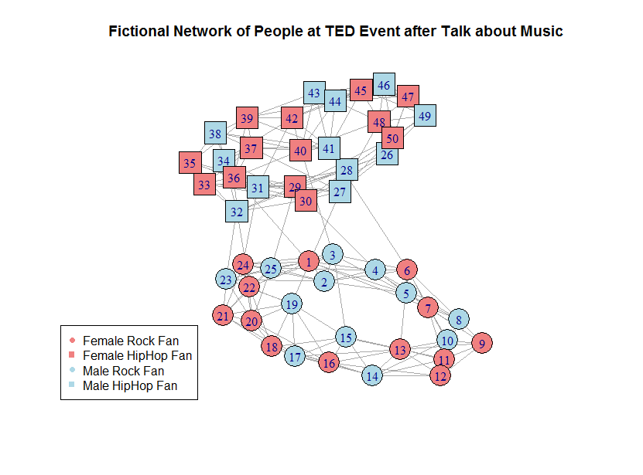
Psychology of Groups
Meta-Contrast Principle
Notes:
Minimal group paradigm <-> Minimal intergroup situation

Slide 24
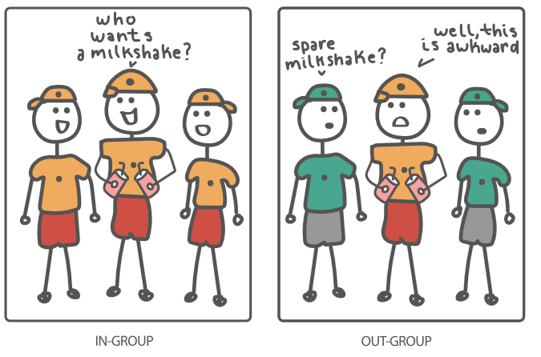
Psychology of Groups
In-group favoritism
Even for minimal groups, people will prefer others from their in-group and treat them more favorably.
Minimal Groups:
No shared history
No future contact
No implications of group membership
Notes:
Minimal group paradigm <-> Minimal intergroup situation

Slide 25
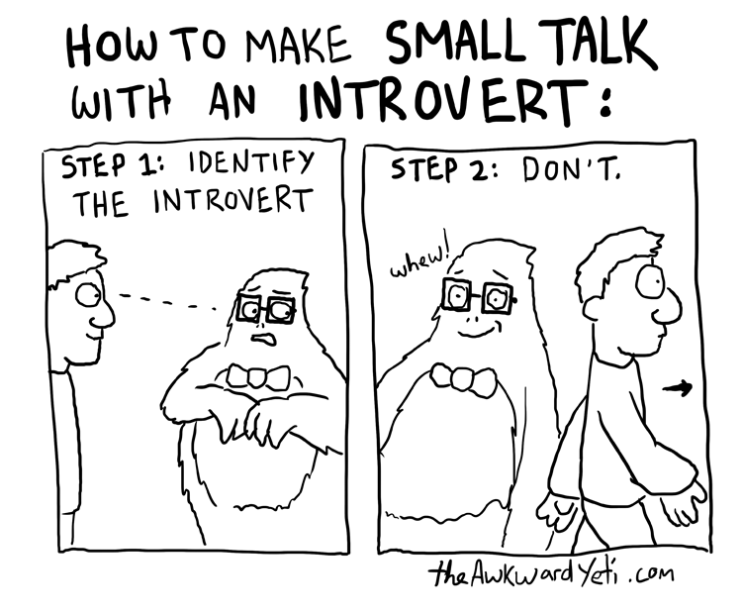

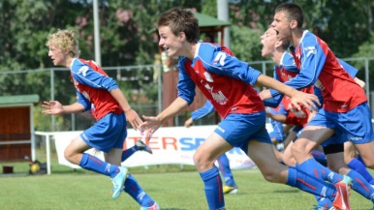
Psychology of Groups
Group Formation
Individual Differences:
High Extraversion
High Agreeableness
High Relationality
Gender Tendencies:
Women: Smaller, supportive,
Relationship-oriented groups
Men: Larger, competetive,
Goal-oriented groups
Notes:
Minimal group paradigm <-> Minimal intergroup situation

Slide 26
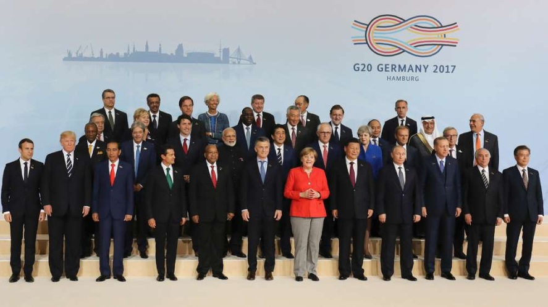
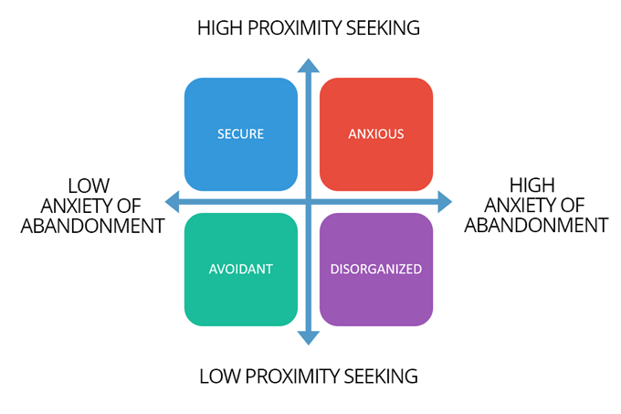
Psychology of Groups
Group Formation
Motivations:
Need to Belong
Status / Power
Support
Attachment Style:
Secure
Notes:
Innocuous sociability: Blending into the background of the group without becoming too personally involved
Attachment Styles: Anxious: spend less times in groups, fewer collective activities, less satisfied with groups
Avoidant: groups less important to them, more likely to leave the group, spent more time alone

Slide 27
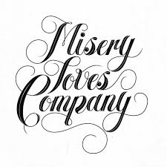
Psychology of Groups
Group Formation
Situational Factors:
Prior positive experience
„Misery loves miserable company“
Emotional Loneliness
Social Loneliness
Support
Belonging
Informational support
Emotional support
Instrumental support
Notes:
Innocuous sociability: Blending into the background of the group without becoming too personally involved
Attachment Styles: Anxious: spend less times in groups, fewer collective activities, less satisfied with groups
Avoidant: groups less important to them, more likely to leave the group, spent more time alone

Slide 28
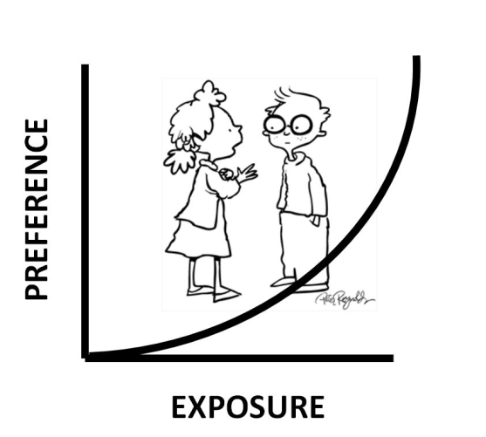
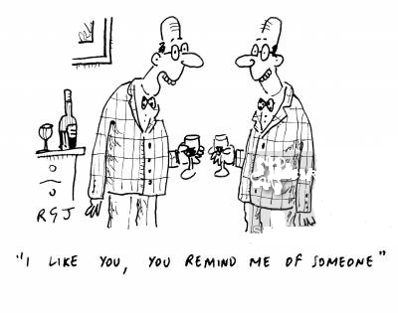

Psychology of Groups
Group Formation
Attraction:
Proximity principle
Elaboration principle
Familiarity Principle
Similarity Principle
Notes:
Innocuous sociability: Blending into the background of the group without becoming too personally involved
Attachment Styles: Anxious: spend less times in groups, fewer collective activities, less satisfied with groups
Avoidant: groups less important to them, more likely to leave the group, spent more time alone

Slide 29
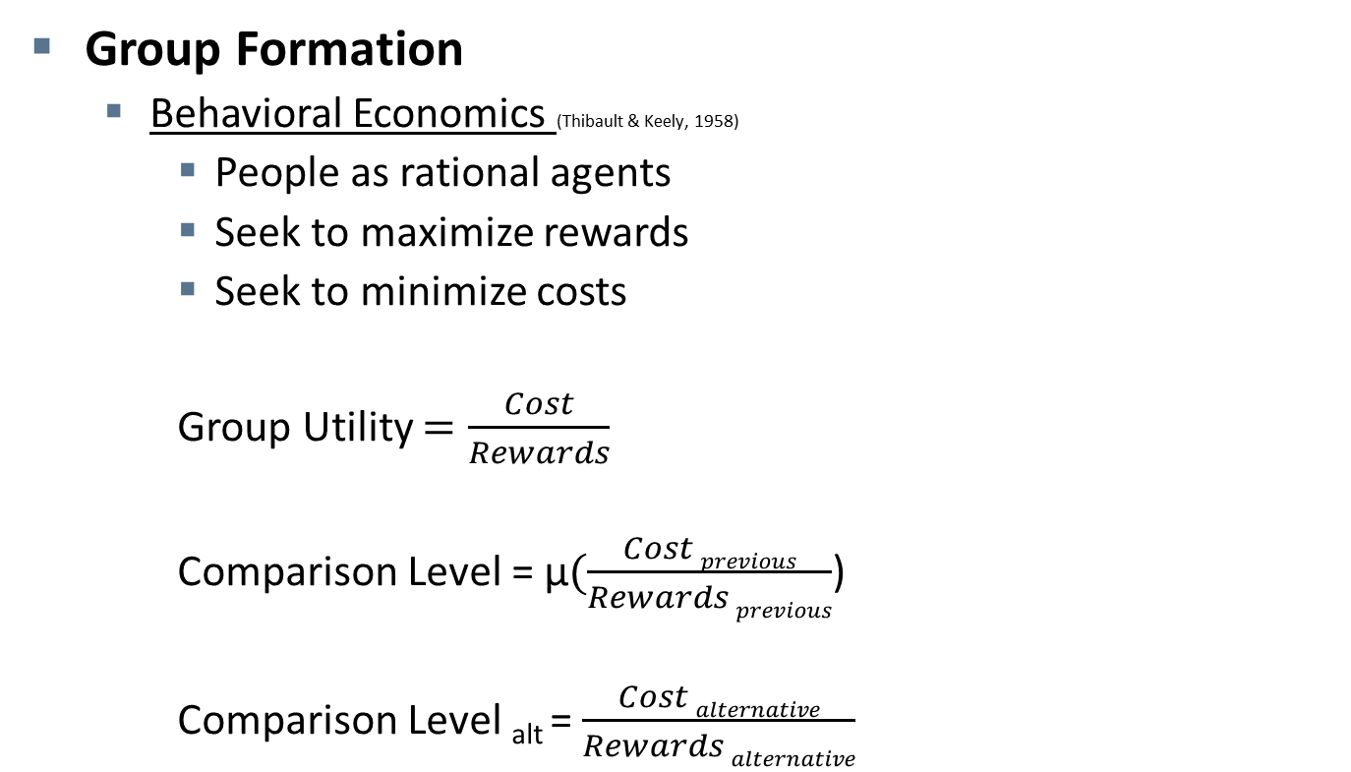
Psychology of Groups
Group Formation
Behavioral Economics (Thibault & Keely, 1958)
People as rational agents
Seek to maximize rewards
Seek to minimize costs
Group Utility $=\frac{Cost}{Rewards}$
Comparison Level = μ$(\frac{Cost previous}{Rewards previous}$)
Comparison Level _{alt} =$\frac{Cost alternative}{Rewards alternative}$
GU > CL
GU < CL
Join group
satisfied
Join group
dissatisfied
GU > CL_{alt}
GU < CL_{alt}
Doesn´t join group
satisfied
Doesn´t join group
dissatisfied
Notes:
Innocuous sociability: Blending into the background of the group without becoming too personally involved
Attachment Styles: Anxious: spend less times in groups, fewer collective activities, less satisfied with groups
Avoidant: groups less important to them, more likely to leave the group, spent more time alone

Slide 30
Psychology of Norms

Slide 31




Psychology of Norms
What are Norms?
„Shared rules of Action“ (Burns, Baumgartner & DeVille, 1985)
„Social Standards that are accepted by a substantial proportion of the group“ (Forsyth, 2007)
Prescriptive Norms
Proscriptive Norms
Descriptive Norms
Injunctive Norms
Emergent & Consensual
Notes:
Example:
Wearing a suit to a wedding
Saying „bless you“ when someone sneezes
Carrying a baby to term when you get pregnant
Not studying for exams
Starting to consume drugs

Slide 32
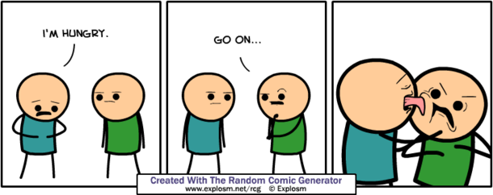

Psychology of Norms
What are Norms good for?
Organizing social interaction
Make behavior of others predictable to a certain extent
Everybody gives up personal freedom to enable productive coexistence in groups
Notes:
Ash conformity experiment (1951)

Slide 33
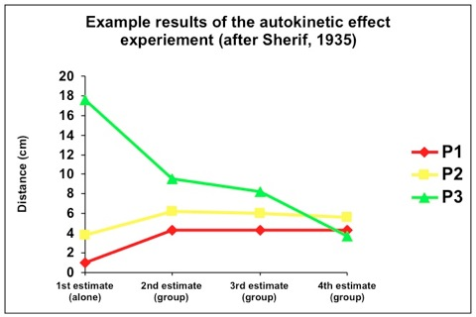
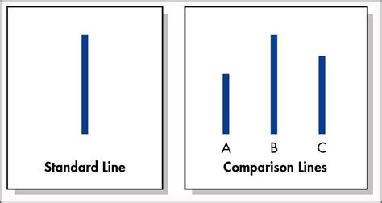
Psychology of Norms
How do norms develop?
„Norms emerge gradually as group members align their behaviors, attitudes, values and beliefs over time“ (Forsyth, 2007)
Groups sometimes explicitly discuss norms but most often, members implicitly align on rules of behavior.
Notes:
Ash conformity experiment (1951)

Slide 34
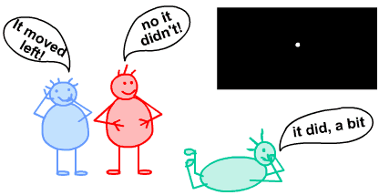
Psychology of Norms
How are Norms transferred?
Observational Learning
Generational Paradigm:
We can create a group of people, let them develop some norm and then gradually replace members until none of the old members is still present. (McNeil & Sherif, 1976)
Autokinetic effect study with confederate outlier
groups converge on higher average
It took 5-6 iterations with completely new members to completel iradicate the bias
Individuals had internalized the norm even after the group dissolved
Norms resist revision

Slide 35
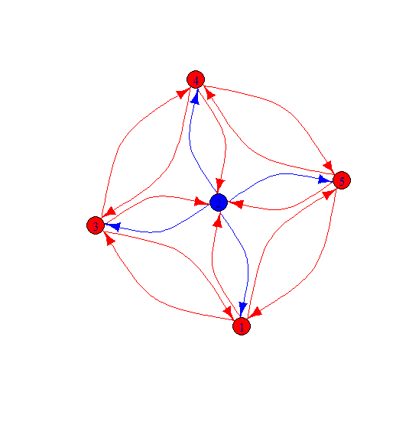
Psychology of Norms
Social Influence in Groups
Interpersonal processes that change the attitudes, norms and behaviors of people
Notes:
Examples:
Using the small fork for the salad because everyone else is doing it
Children adopting the political views of their parents

Slide 36
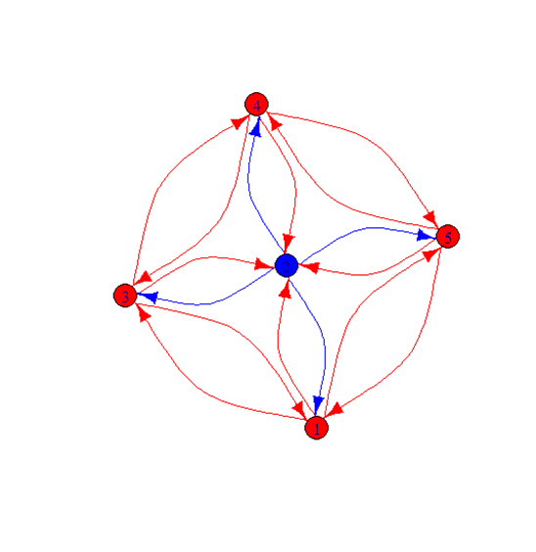
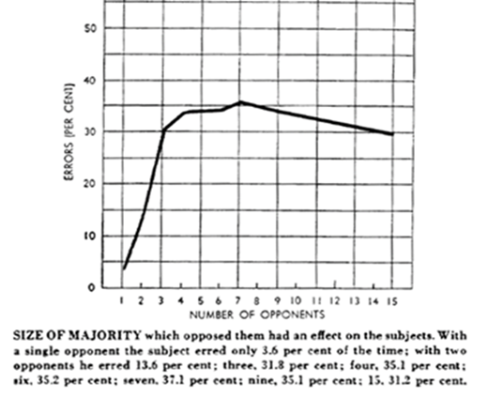
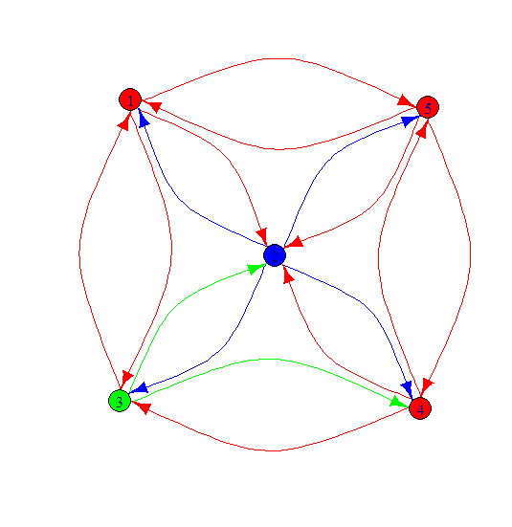
Psychology of Norms
Social Influence in Groups
Majority Influence
Conformity (Ash, 1951)
Unanimity is extremely powerful
Diminishing returns (max at ~3)
Notes:
However: It seems to be important if the person to be influences perceives
The others as a collection of individual decision makers or a group that arrived at the conclusion together
Group is LESS influential.

Slide 37


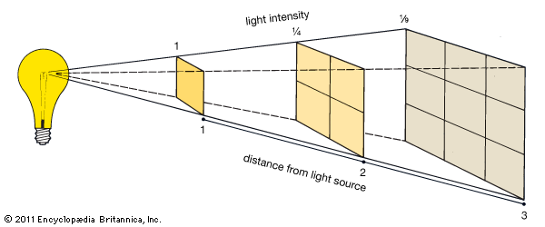

Psychology of Norms
Social Influence in Groups
Social Impact Theory (Latané, 1981)
„Lightbulb theory of social impact“
Strength
Immediacy
Number
Notes:
However: It seems to be important if the person to be influences perceives
The others as a collection of individual decision makers or a group that arrived at the conclusion together
Group is LESS influential.

Slide 38
Psychology of Norms
Social Influence in Groups
Reactions to Social Influence:
Congruence: initial match
Compliance: only publically agree
Conversion: legitimate cange
Dissent: staying openly independent
Anticonformity: antagonistic vocalization
Although conformity is often stated as an example of conversion, most people stay independent (Ash, 1951: ¾ of people were not influenced)
Notes:
However: It seems to be important if the person to be influences perceives
The others as a collection of individual decision makers or a group that arrived at the conclusion together
Group is LESS influential.

Slide 39
Psychology of Norms
Social Influence in Groups
Personal Factors determining reaction to social influence:
Authoritarianism
Gender / Gender identity
Individualism/Collectivism
Intelligence
Self-esteem
Need for Closure
Need for Uniqueness
Need to Belong
Extraversion, Agreeableness
Notes:
However: It seems to be important if the person to be influences perceives
The others as a collection of individual decision makers or a group that arrived at the conclusion together
Group is LESS influential.

Slide 40
Psychology of Norms
Social Influence in Groups
Situational Factors determining reaction to social influence:
Increases Conformity | Decreases Conformity
Group Cohesiveness | Anonimity
Large Group Size | Status
Unanimity | Allies
Formal Structure | History of poor decisions
Commitment | Norms underlining creativity
Accountability
Task-difficulty
Notes:
However: It seems to be important if the person to be influences perceives
The others as a collection of individual decision makers or a group that arrived at the conclusion together
Group is LESS influential.

Slide 41
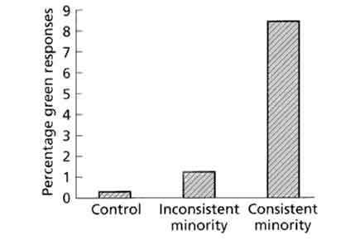
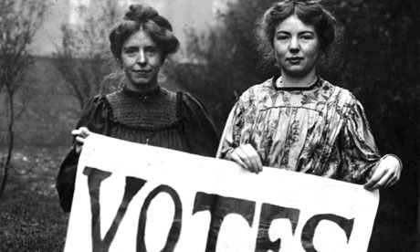

Psychology of Norms
Social Influence in Groups
Minority Influence (Moscovici, 1961):
Sometimes, the minority influences the majority and not vice versa.
Notes:
However: It seems to be important if the person to be influences perceives
The others as a collection of individual decision makers or a group that arrived at the conclusion together
Group is LESS influential.

Slide 42
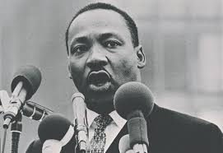
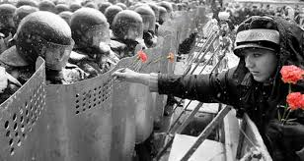
Psychology of Norms
Social Influence in Groups
Factors that increase Minority influence:
Consistency
Retaining positive interpersonal relationships
Minor concessions
No thread to integrity of group
Notes:
However: It seems to be important if the person to be influences perceives
The others as a collection of individual decision makers or a group that arrived at the conclusion together
Group is LESS influential.

Slide 43
Psychology of Norms
Social Influence in Groups
Routes of Influence (Moscovici, 1961)
Majority -> Minority:
Compliance
Heurisitc Route
Normative Influence
Minority -> Majority:
Conversion
Deliberate Route
Informational Influence
Notes:
When people are told that they are in the minority with their opinion, they prepare
Their positions a lot more thoroughly and use more creative arguments

Slide 44
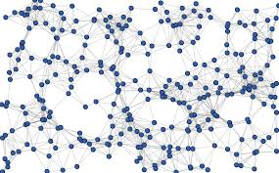
Psychology of Norms
Dynamic Social Impact Theory (Latané, 1996)
Groups as complex system with reciprocative influence dynamics
Consolidation
Clustering
Correlation
Continuing Diversity
Notes:
Consolidation: Through interaction, people converge to a norm/group standard and minorities dwindle in size
Clustering: People are more strongly influenced by their closest nieghbors
Correlation: People tend to converge generally, not only on issues that are explicitly discussed
Continuing diversity: Because of clustering, Minorities are often shielded from the influence of the majority and
Can continue to exist.

Slide 45
Psychology of Norms
Cognitive Biases in Social Impact
False Consensus Effect
Inhibitory Anxiety for violating Norms
Black-Sheep effect
Shared Information Bias
Group Polarization
Valueing ingroup information more strongly (Denvell & Mens, 2007)
Notes:
Consolidation: Through interaction, people converge to a norm/group standard and minorities dwindle in size
Clustering: People are more strongly influenced by their closest nieghbors
Correlation: People tend to converge generally, not only on issues that are explicitly discussed
Continuing diversity: Because of clustering, Minorities are often shielded from the influence of the majority and
Can continue to exist.

Slide 46
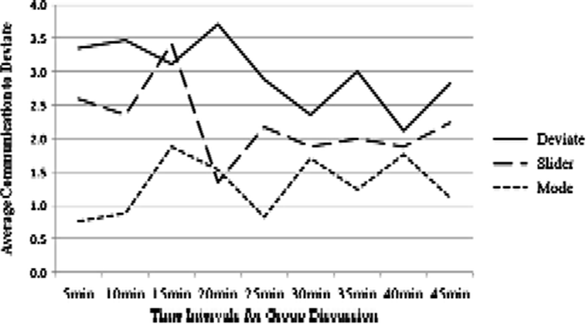
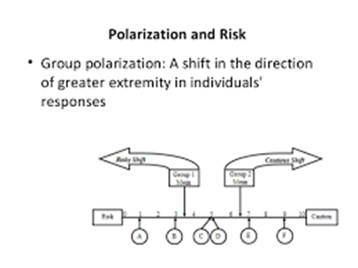
Psychology of Norms
Cognitive Biases in Social Impact
Efforts to convince
Risky-Shift / Attitude Ploarization
Notes:
Consolidation: Through interaction, people converge to a norm/group standard and minorities dwindle in size
Clustering: People are more strongly influenced by their closest nieghbors
Correlation: People tend to converge generally, not only on issues that are explicitly discussed
Continuing diversity: Because of clustering, Minorities are often shielded from the influence of the majority and
Can continue to exist.

Slide 47
Psychology of Intergroup Conflict

Slide 48
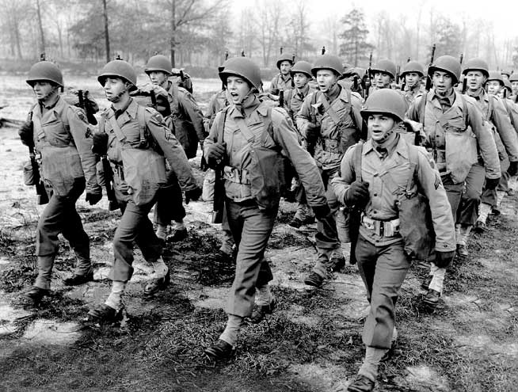
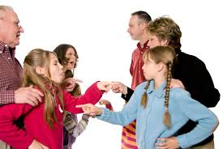

Psychology of Intergroup Conflict
Intergroup conflict occurs at all levels of social organization

Slide 49
Psychology of Intergroup Conflict
Necessary Condition:
Minimal groups
„Us vs. Them“
Trigger:
Competition for resources or status (zero sum games)
Moral issues / Norms
Morality is often used as a more acceptable cause for intergroup conflict („Peace Missions“)

Slide 50
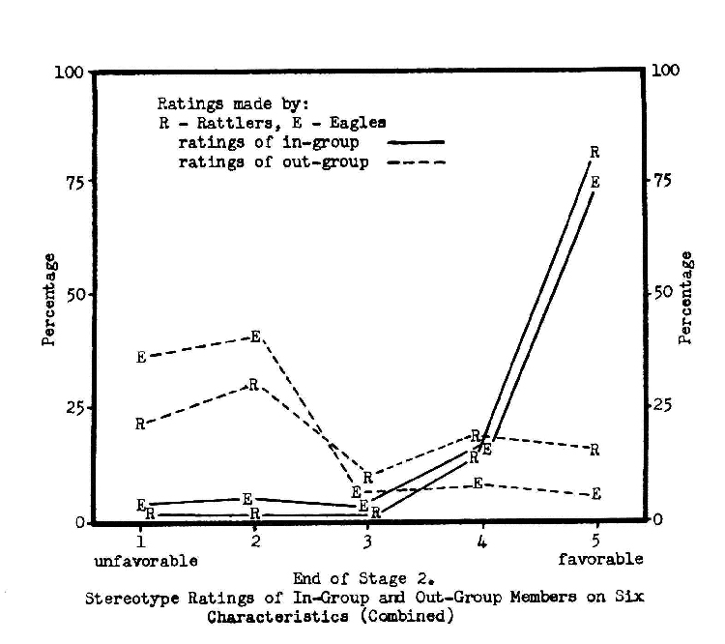
Psychology of Intergroup Conflict
Rattlers & Eagles (Sherif & Sherif, 1954)

Slide 51
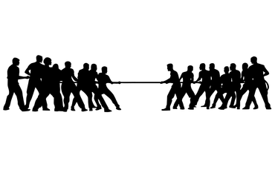
Psychology of Intergroup Conflict
Discontinuity Effect (Wildshout, 2003)
“Groups tend to compete harder against each other than single individuals“
Group polarization towards competetiveness
Intergroup- paranoia (Kramer, 2004)

Slide 52

Psychology of Intergroup Conflict
Social Dominancy Theory (Sidenious & Pratto, 1999)
Tendency to form subgroups with competition for resources and status
Unfair distribution of resources and status
The exploited will rebel, the dominant group will try to defend the status quo

Slide 53
Psychology of Intergroup Conflict
Intergroup Conlfict is often extended, amplified or sustained by a number of cognitive biases in the group context
Social Categorization
Ingroup-Outgroup Bias
Ultimate Attribution Error
Group Attribution Error
Stereotyping
Outgroup Homogeneity Bias
Double-Standard thinking (Oskamp & Hartey, 1968)

Slide 54

Psychology of Intergroup Conflict
Resolving Conflict
Contact Hypothesis: Sustained contact between groups will reduce conflict and hostility. (Allport, 1954)
Equal Status
Personal interaction
Supportive norms
Cooperation
Redefining Groups:
Cross-categorization
Common Identity
Common Enemy
Personalization

